Slide 1
Progressive Web Applications
Josiah Shirley
&
Caber Caldwell

Slide 2




What are PWA’s
App made with web platform technologies
Is installable
Can run offline
Can use device tools
Microphone
Location tracking
etc.
Examples

Slide 3
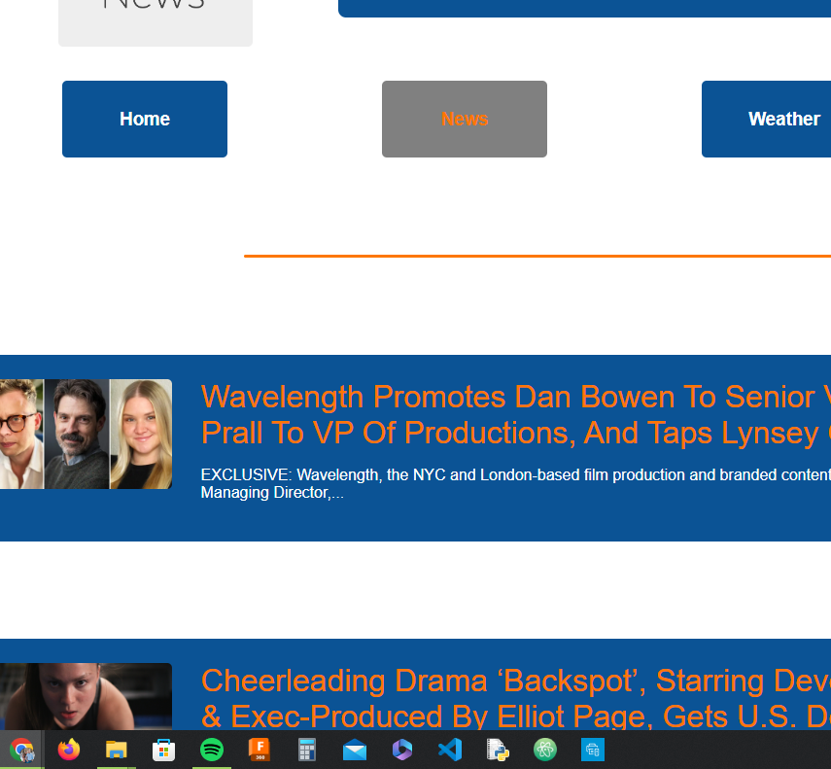
Our App
Business Source News

Slide 4
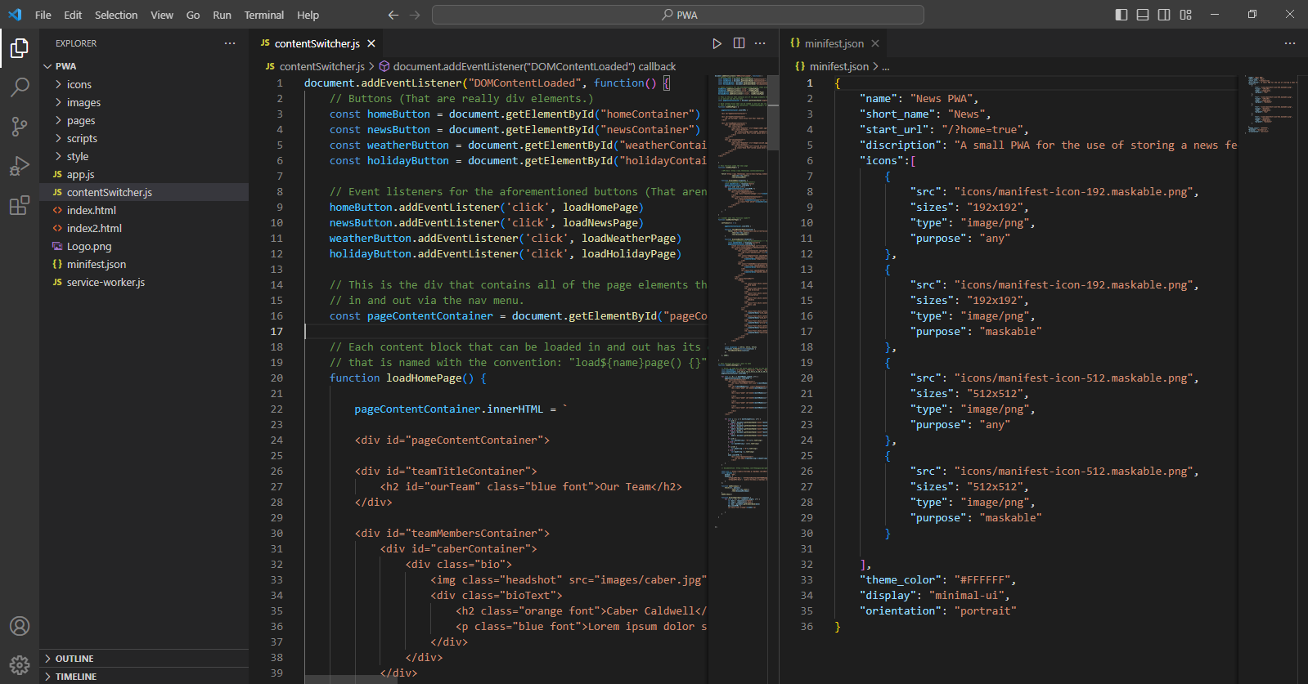
Our Code Base
HTML
CSS
JavaScript
JSON

Slide 5
Let’s look closer at the code!

Slide 6
Now let’s see the app!

Slide 7
Thank you.

